Slide 1



School of Computing and Information Technology, Eastern International University (EIU) - Vietnam

Slide 2

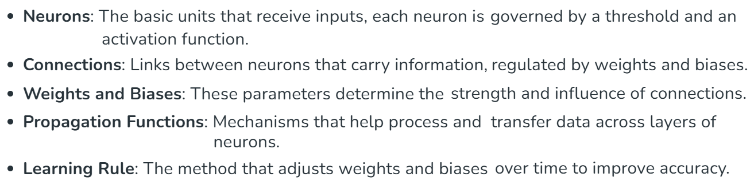
School of Computing and Information Technology, Eastern International University (EIU) - Vietnam

Slide 3
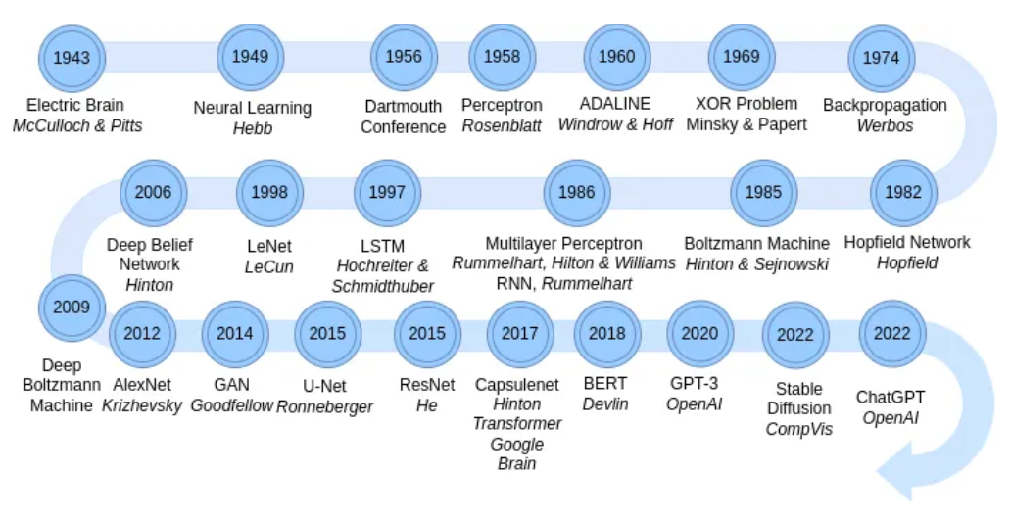
School of Computing and Information Technology, Eastern International University (EIU) - Vietnam

Slide 4
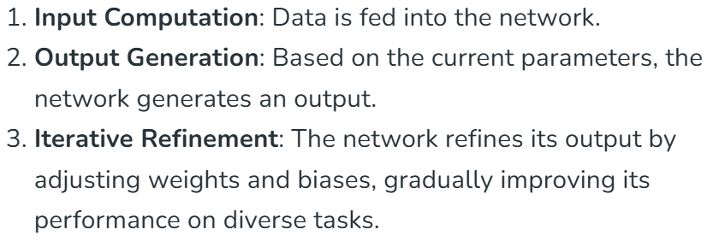
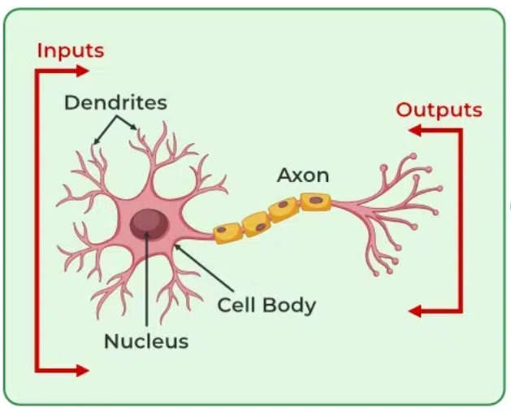

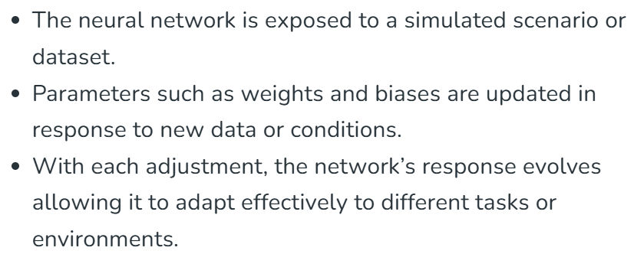
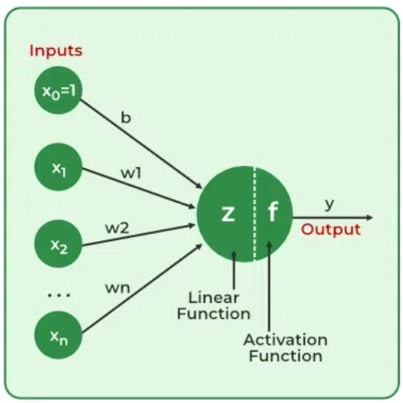

Slide 5
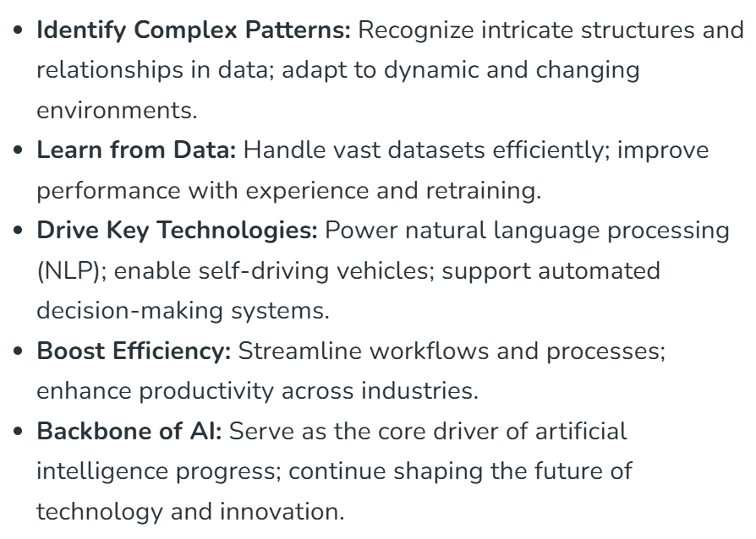


School of Computing and Information Technology, Eastern International University (EIU) - Vietnam

Slide 6
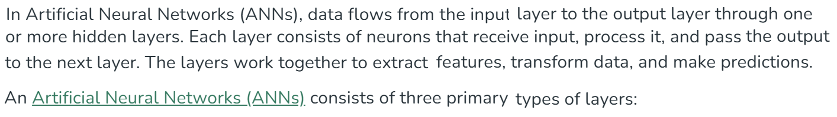
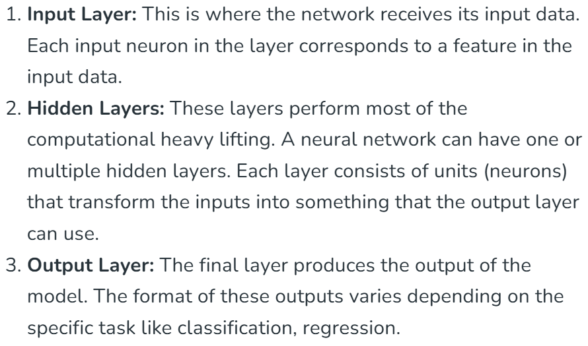
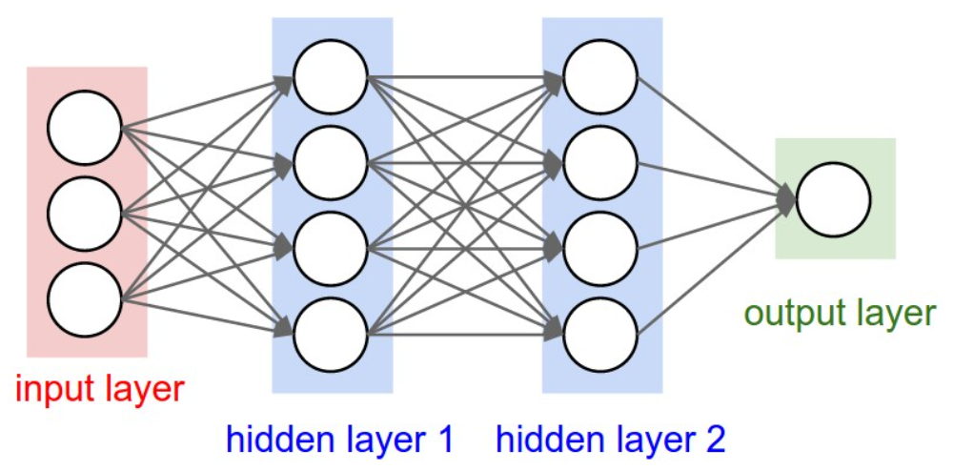
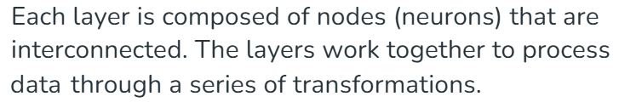

Slide 7

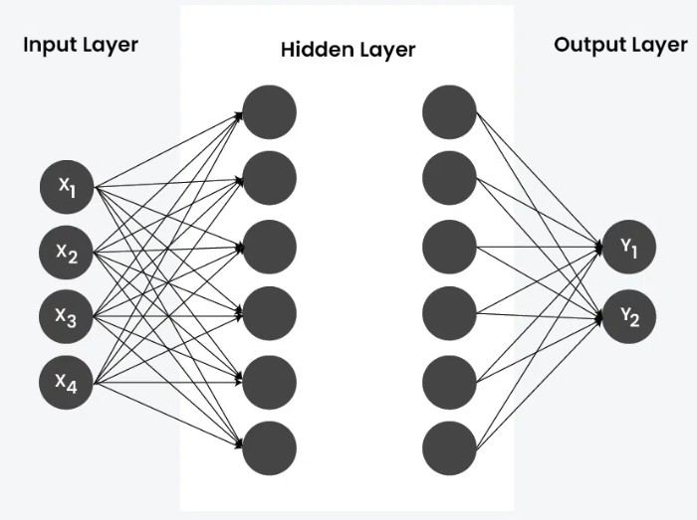
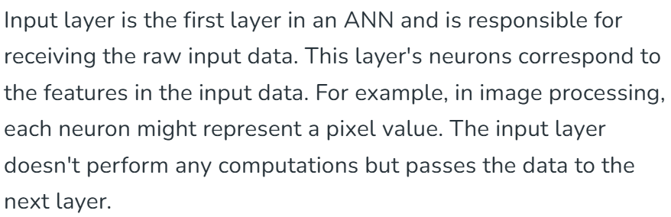
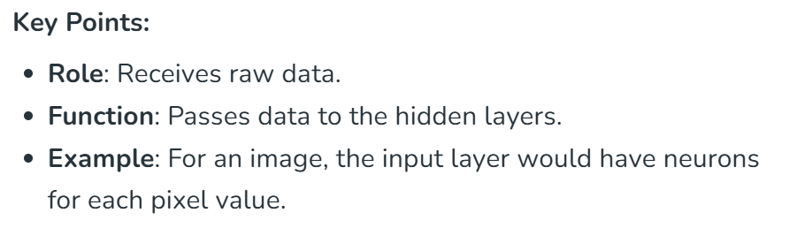

School of Computing and Information Technology, Eastern International University (EIU) - Vietnam

Slide 8

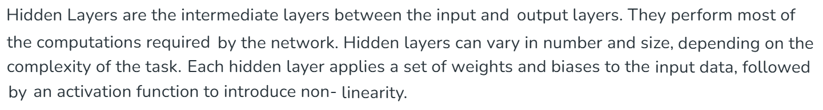

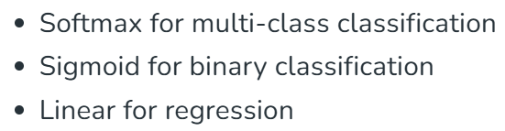
School of Computing and Information Technology, Eastern International University (EIU) - Vietnam

Slide 9
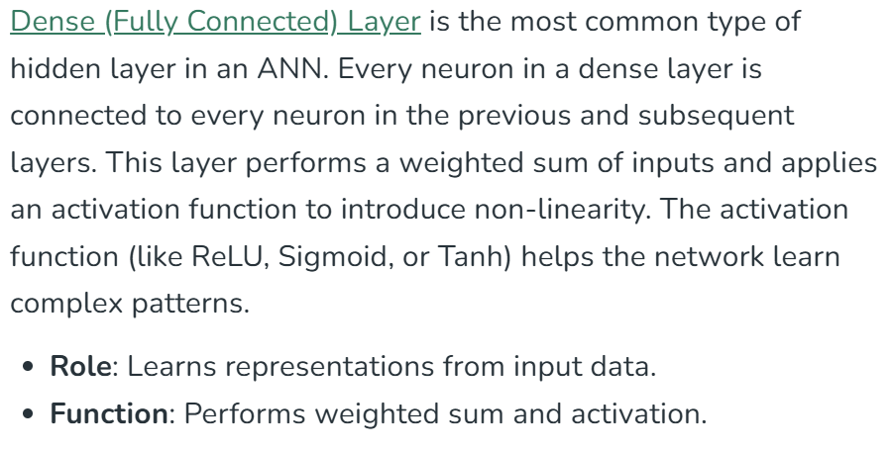
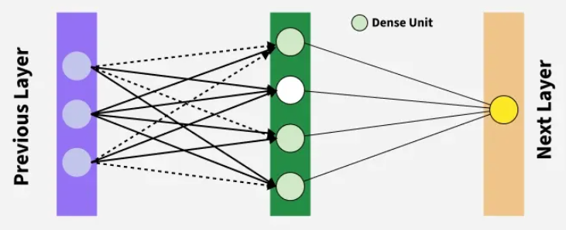

School of Computing and Information Technology, Eastern International University (EIU) - Vietnam

Slide 10

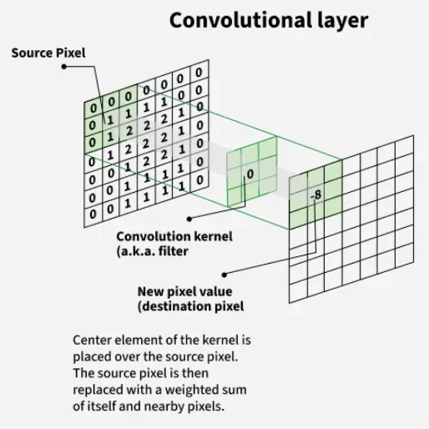
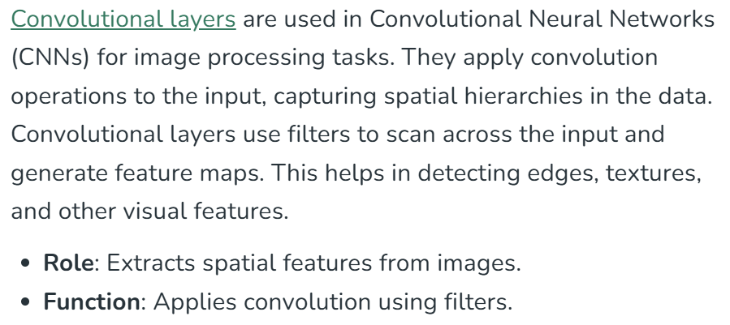

School of Computing and Information Technology, Eastern International University (EIU) - Vietnam

Slide 11

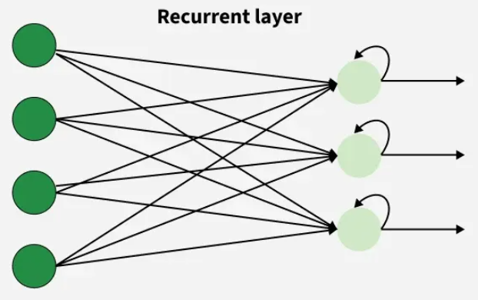
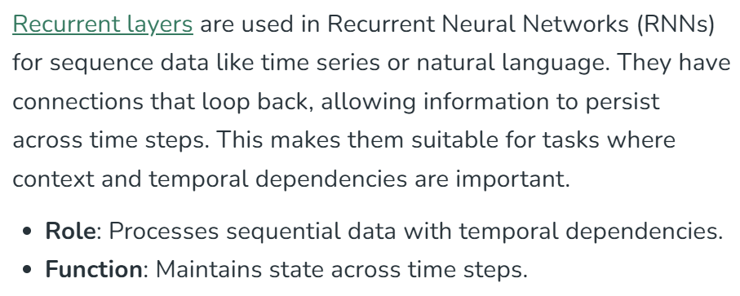


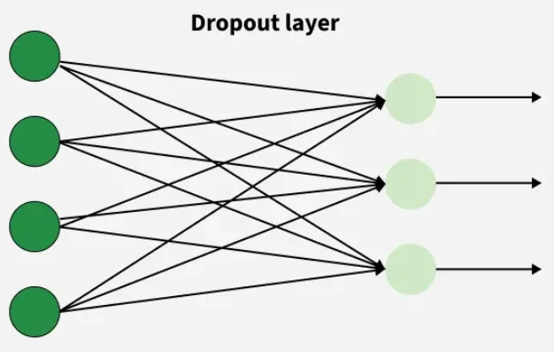
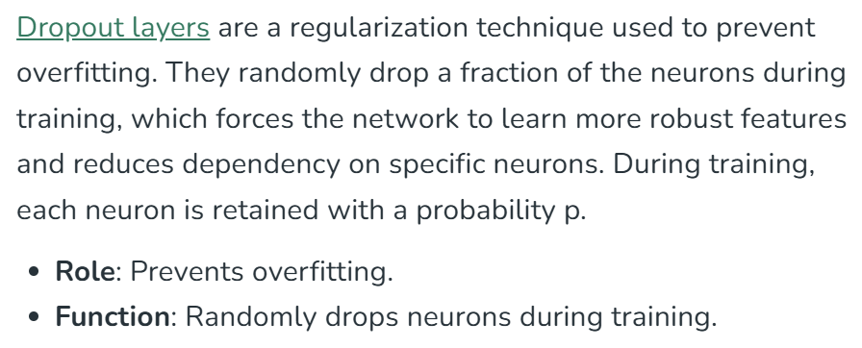


Slide 12

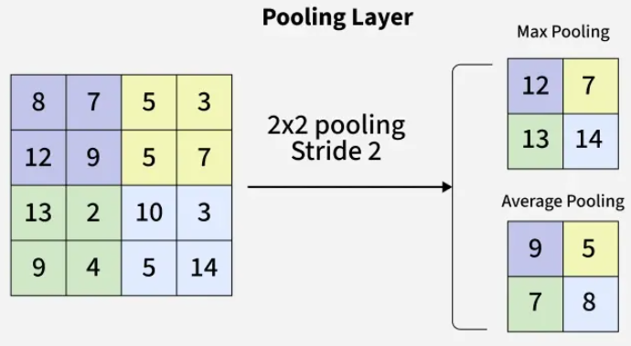
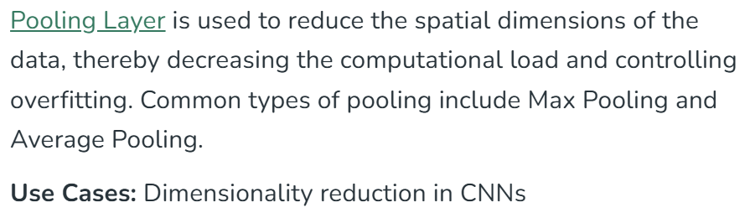

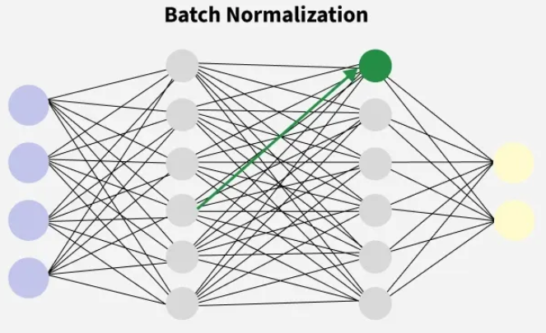
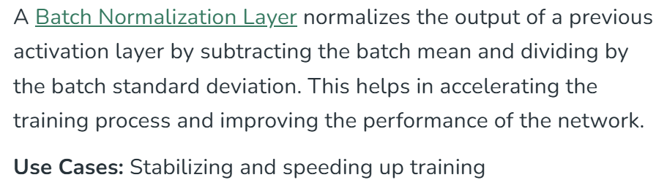


Slide 13

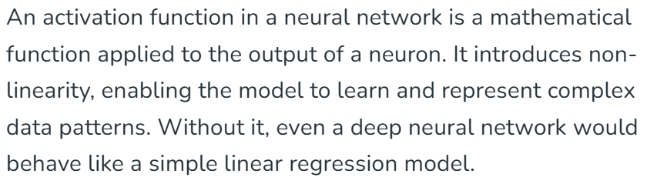
School of Computing and Information Technology, Eastern International University (EIU) - Vietnam

Slide 14
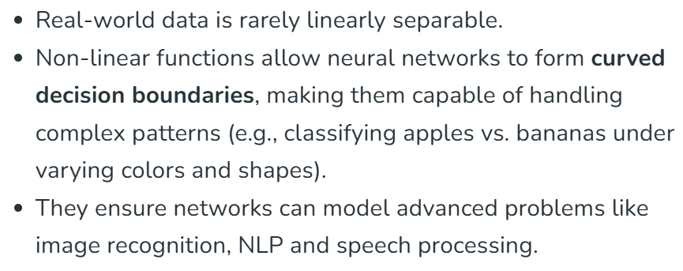
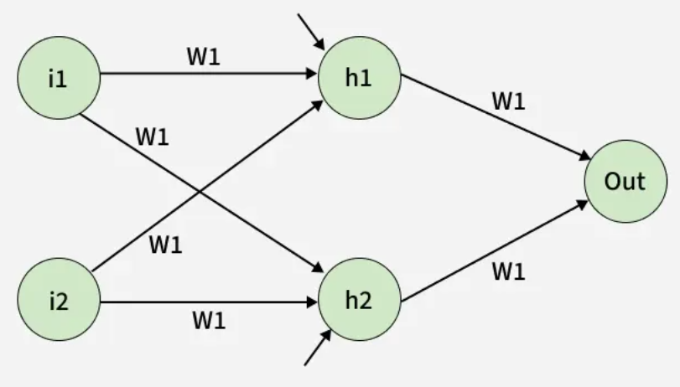

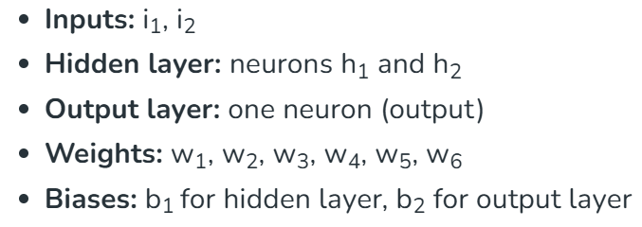

Slide 15
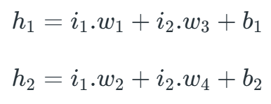





School of Computing and Information Technology, Eastern International University (EIU) - Vietnam

Slide 16

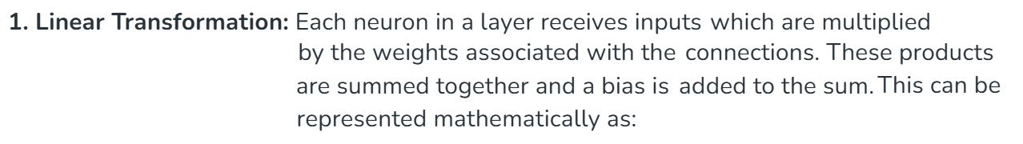

School of Computing and Information Technology, Eastern International University (EIU) - Vietnam

Slide 17
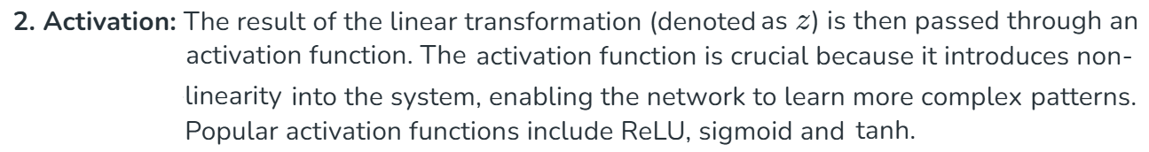

School of Computing and Information Technology, Eastern International University (EIU) - Vietnam

Slide 18
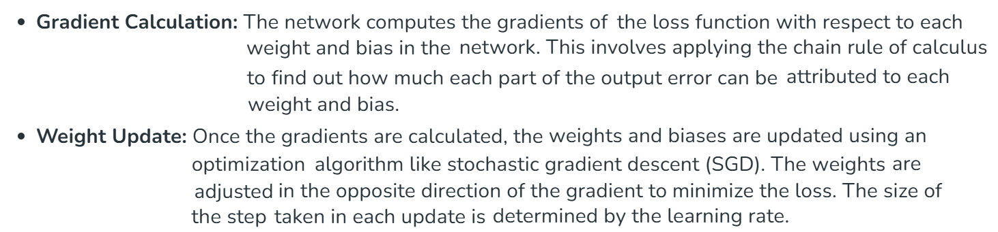

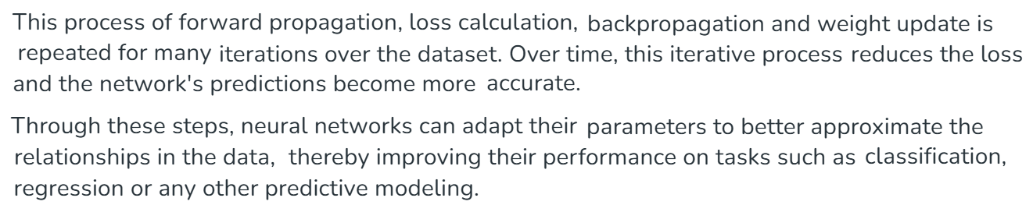

Slide 19


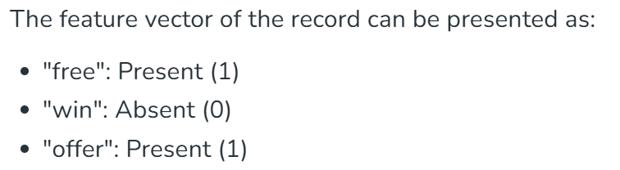
School of Computing and Information Technology, Eastern International University (EIU) - Vietnam

Slide 20
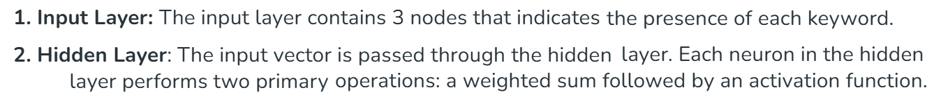
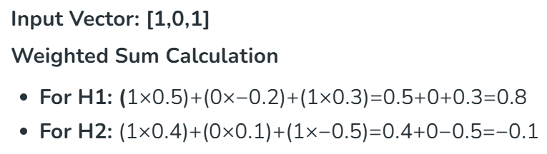
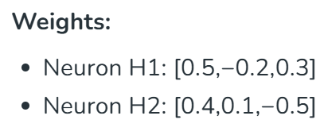
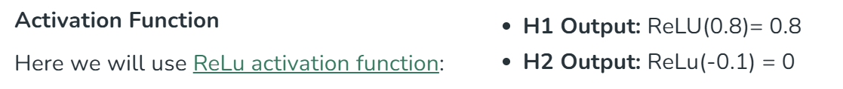

Slide 21
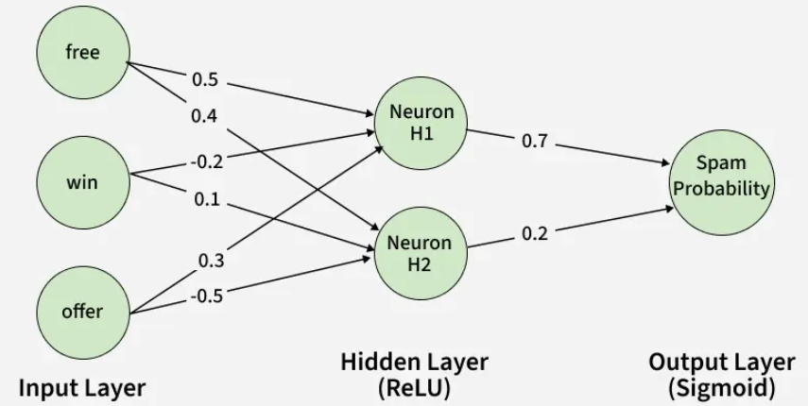
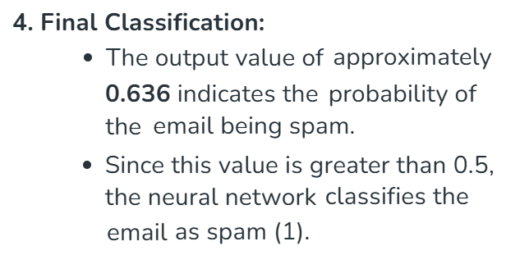

School of Computing and Information Technology, Eastern International University (EIU) - Vietnam

Slide 22

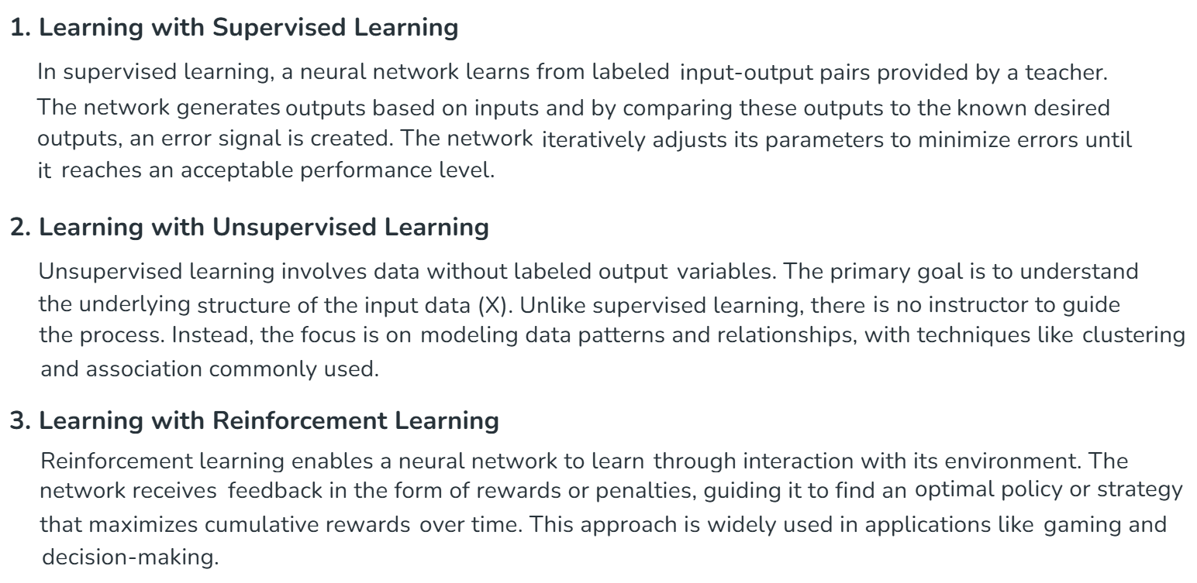

Slide 23

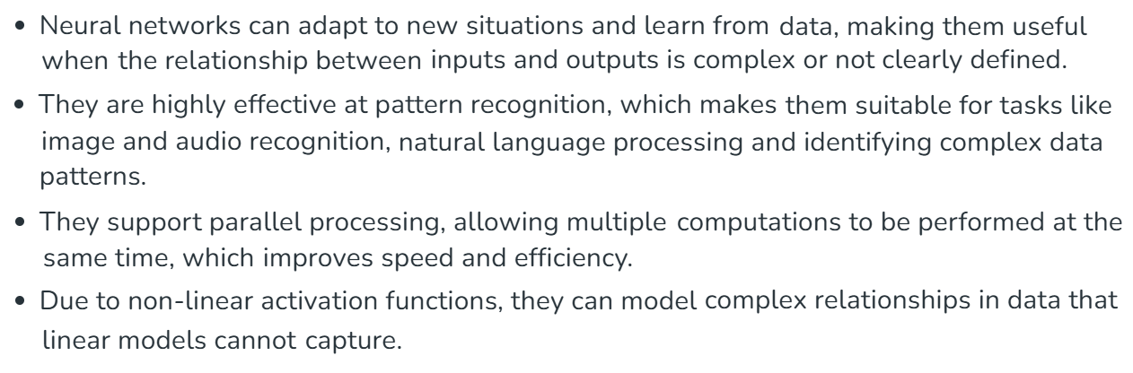
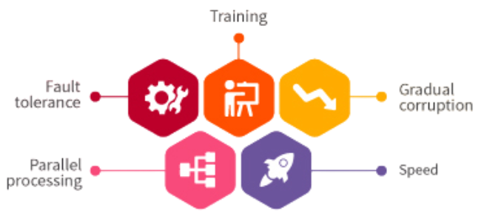

Slide 24

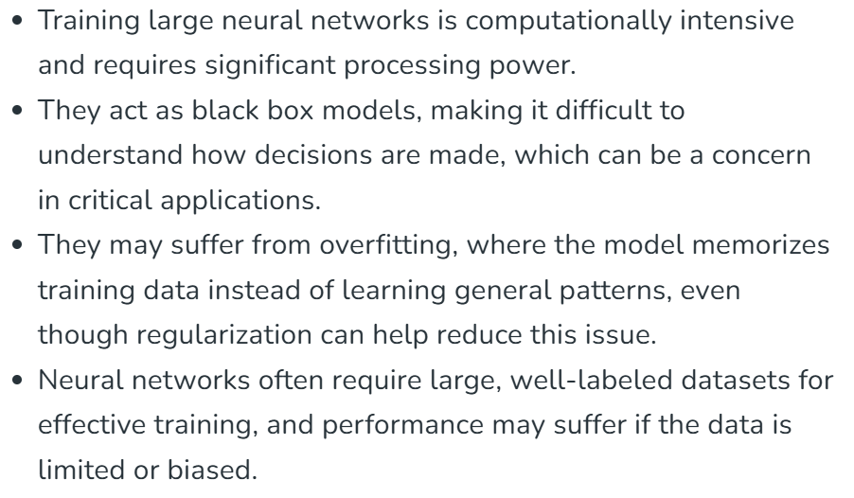
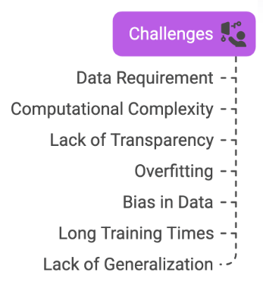
School of Computing and Information Technology, Eastern International University (EIU) - Vietnam

Slide 25

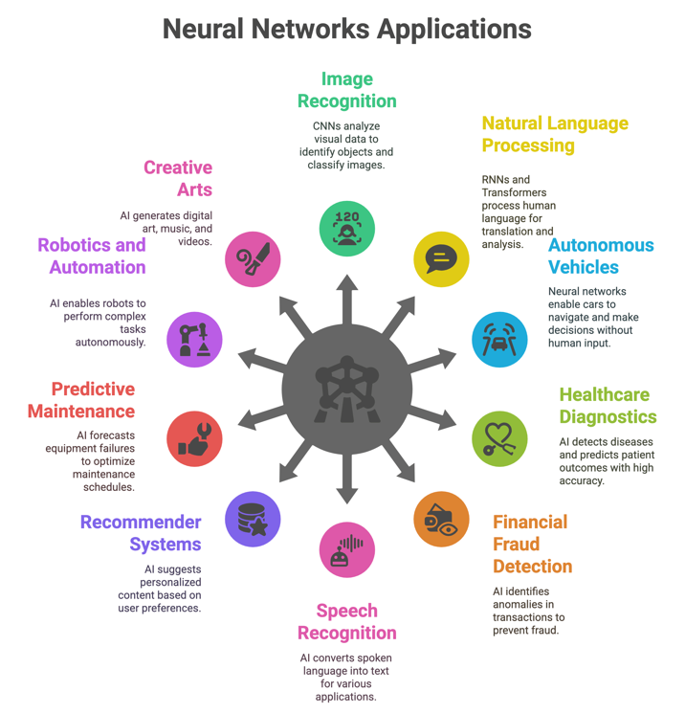

School of Computing and Information Technology, Eastern International University (EIU) - Vietnam

Slide 26



Slide 27



School of Computing and Information Technology, Eastern International University (EIU) - Vietnam

Slide 28




Slide 29





School of Computing and Information Technology, Eastern International University (EIU) - Vietnam

Slide 30



School of Computing and Information Technology, Eastern International University (EIU) - Vietnam

Slide 31


School of Computing and Information Technology, Eastern International University (EIU) - Vietnam

Slide 32



Slide 33

School of Computing and Information Technology, Eastern International University (EIU) - Vietnam

Slide 34




School of Computing and Information Technology, Eastern International University (EIU) - Vietnam

Slide 35




School of Computing and Information Technology, Eastern International University (EIU) - Vietnam

Slide 36










Slide 37










School of Computing and Information Technology, Eastern International University (EIU) - Vietnam

Slide 38



School of Computing and Information Technology, Eastern International University (EIU) - Vietnam

Slide 39








School of Computing and Information Technology, Eastern International University (EIU) - Vietnam

Slide 40










School of Computing and Information Technology, Eastern International University (EIU) - Vietnam

Slide 41




School of Computing and Information Technology, Eastern International University (EIU) - Vietnam

Slide 42


School of Computing and Information Technology, Eastern International University (EIU) - Vietnam

Slide 43


School of Computing and Information Technology, Eastern International University (EIU) - Vietnam

Slide 44


School of Computing and Information Technology, Eastern International University (EIU) - Vietnam

Slide 45



Slide 46

School of Computing and Information Technology, Eastern International University (EIU) - Vietnam

Slide 47



School of Computing and Information Technology, Eastern International University (EIU) - Vietnam

Slide 48



Slide 49




School of Computing and Information Technology, Eastern International University (EIU) - Vietnam

Slide 50




Slide 51



Slide 52





Slide 53






Slide 54






Slide 55





Slide 56

School of Computing and Information Technology, Eastern International University (EIU) - Vietnam

Slide 57




School of Computing and Information Technology, Eastern International University (EIU) - Vietnam

Slide 58






Slide 59





Slide 60



School of Computing and Information Technology, Eastern International University (EIU) - Vietnam

Slide 61


School of Computing and Information Technology, Eastern International University (EIU) - Vietnam

Slide 62



School of Computing and Information Technology, Eastern International University (EIU) - Vietnam

Slide 63

School of Computing and Information Technology, Eastern International University (EIU) - Vietnam

Slide 64






Slide 65




Slide 66


Slide 67





Slide 68





Slide 69





Slide 70



School of Computing and Information Technology, Eastern International University (EIU) - Vietnam

Slide 71


School of Computing and Information Technology, Eastern International University (EIU) - Vietnam

Slide 72

School of Computing and Information Technology, Eastern International University (EIU) - Vietnam

